Slide 1

Kindly hosted by the Blockchain Lab Webinars and events, University of Comillas. Spain
XBRLchain webinar. 2018-10-29 15:00 CET
Jesus Ruiz, CTO at Alastria Blockchain Ecosystem. jesus@alastria.io
Javier Mora, XBRL senior expert. Javier.Mora@xbrl.org.es
Ignacio Boixo, Openfiling Association, Founder. ignacio@boixo.com
Kindly hosted by the Blockchain Lab - Webinars and Events

Slide 2
A description of the
existing mechanism for publication of
Financial Regulatory Reports

Slide 3

Step 1: The Issuer prepares a report.
Issuer
Unaudited Report

Slide 4

Step 2: The Auditor signs the audited report.
Issuer
Unaudited Report
Audited Report
Auditor

Slide 5
Step 3: The Issuer files the report to the Supervisor.
Issuer
Report
Supervisor
Unaudited Report
Audited Report
Auditor

Slide 6
Step 4: The Supervisor made the report public to the market.
Issuer
Report
Supervisor
PublicationWeb
Unaudited Report
Audited Report
Auditor

Slide 7

Step 5: The investor Anna finds and reads the report.
Issuer
Report
Supervisor
PublicationWeb
← Query?
Anna
Report
Unaudited Report
Audited Report
Auditor

Slide 8
Step 6: In other Jurisdiction other issuer files another report, to be published and read by Bob.
Issuer
Report
Supervisor
PublicationWeb
← Query?
Anna
Report
Unaudited Report
Audited Report
PublicationWeb
Report
Bob
Auditor
Report
← Query?
OAM

Slide 9

Step 7: Carol receives reports from Anna, Bob and others. What about Integrity and Non-repudiation?
Issuer
Report
Supervisor
PublicationWeb
← Query?
Anna
Report
Reports
Supply
Chain
Unaudited Report
Audited Report
PublicationWeb
Report
Bob
Auditor
Report
← Query?
OAM
Integrity ?
Non-repudiation ?
Carol
Report

Slide 10
XBRLchain = XBRL secured by blockchain

Slide 11
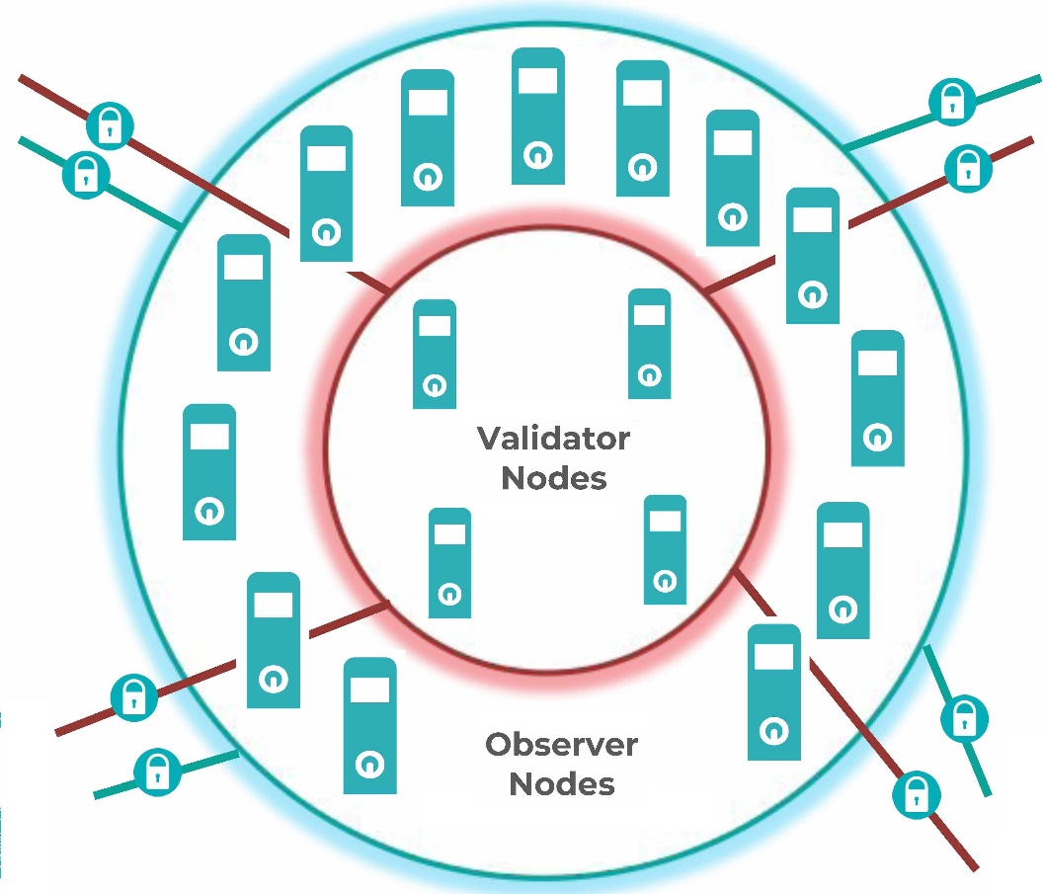
Hash 1: The Supervisor notarizes the hash code of the report when it is made public.
Supervisor
PublicationWeb
Notarize
Hash

Slide 12
Hash 2: Other Supervisors/OAMs (and Auditors and Issuers, if allowed) can also notarize reports.
Issuer
Report
Supervisor
Notarize
Hash
PublicationWeb
Unaudited Report
Audited Report
Notarize
Hash
Notarize
Hash
PublicationWeb
Auditor
Report
OAM

Slide 13
Hash 3: Carol (and Bob, Anna, OAMs and Supervisors) has now a secure check for Integrity and Non-repudiation.
Issuer
Report
Supervisor
PublicationWeb
Anna
Report
Reports
Supply
Chain
Unaudited Report
Audited Report
PublicationWeb
Report
Bob
Auditor
Check
Hash
Report
OAM
← Check Report’s Hash
Integrity, No repudiation →
Carol
Report
Check Server

Slide 14
XBRLchain = XBRL secured by Blockchain
IssuerA
IssuerB
IssuerC
Notarize: An Identity inserts a Hash
ReportA
ReportB
ReportC
HashC | SupervisorZ
HashB | SupervisorZ
HashC | AuditorX
HashC | IssuerC
HashB | AuditorX
HashA | SupervisorZ
HashA
HashB
HashC
Hash footprint: Biunivocal digest of a report, unrepeatable by nature
Identities acknowledged in this Blockchain
IssuerC
AuditorX
SupervisorZ
Ledger: indelible and public Blockchain pile containing pairs of Hash/Identity

Slide 15
XBRLchain Live Demo

Slide 16

A modest proposal for:

Slide 17

What is the European Financial Transparency Gateway (EFTG)?
EU financial rules (Transparency Directive, 2004/109/EC) require companies listed on EU regulated markets to publish certain financial information, such as annual financial reports. This protects investors by helping them make informed investment decisions. However, this reporting is currently done via national databases, which are not connected to each other or a central platform. This makes it more difficult for investors to assess cross-border investment decisions.
This is the starting point of the European Financial Transparency Gateway, which links existing national databases through distributed ledger technology. This blockchain-based gateway is a simple and affordable way to share information on listed companies, fostering cross-border investment activity and contributes to a well-functioning Capital Markets Union.

Slide 18
EFTG 1: The Supervisor notarizes the hash code and URL of the report when it is made public.
Issuer
Report
Supervisor
PublicationWeb
Anna
Report
Notarize
Hash, URL
Reports
Supply
Chain
Unaudited Report
Audited Report
PublicationWeb
Report
Bob
Auditor
Check
Hash
Report
OAM
Carol
Report
Check Server

Slide 19
EFTG 2: An event is triggered in a Observer Node when the new block containing the notarization is propagated.
Issuer
Report
Supervisor
PublicationWeb
Anna
Report
OK Notarize
Reports
Supply
Chain
Unaudited Report
Audited Report
Event →
Notarize
PublicationWeb
Report
Bob
Auditor
Check
Hash
Report
OAM
Carol
Report
Check Server

Slide 20
EFTG 3: The report is requested to the Supervisor using the Notarized URL
Issuer
Report
Supervisor
PublicationWeb
Anna
Report
URL?↑
Reports’ Index
Reports
Supply
Chain
Unaudited Report
Audited Report
Add URL
PublicationWeb
Report
Bob
Auditor
Check
Hash
Report
OAM
Carol
Report
Check Server

Slide 21
EFTG 4: The report is downloaded for the publication website and included in the Index of Reports
Issuer
Report
Supervisor
PublicationWeb
Anna
Report
Report
Reports’ Index
Reports
Supply
Chain
Unaudited Report
Audited Report
PublicationWeb
Report
Bob
Auditor
Check
Hash
Report
OAM
Carol
Report
Check Server

Slide 22
EFTG 5: Other OAM (or Auditor or Issuer as well) can also notarize other reports when published
Issuer
Report
Supervisor
Notarize
Hash, URL
PublicationWeb
Anna
Report
Reports
Supply
Chain
Unaudited Report
Audited Report
Notarize
Hash
Notarize
Hash, URL
Bob
PublicationWeb
Report
Auditor
Check
Hash
Report
OAM
Carol
Report
Check Server

Slide 23
EFTG 6: Notarized reports are requested to their respective Publication webs and included in the Index of Reports.
Issuer
Report
Supervisor
PublicationWeb
Anna
Report
Reports’ Index
Reports
Supply
Chain
Unaudited Report
Audited Report
Add URL
Event →
Notarize
Report
URL?↓
OK Notarize
PublicationWeb
Report
Bob
Auditor
Check
Hash
Report
OAM
Carol
Report
Check Server

Slide 24
EFTG 7: A query to the Financial Gateway gets a list of URLs of the indexed reports matching the criteria.
Issuer
Report
Supervisor
PublicationWeb
Anna
Report
Reports’ Index
David
Reports
Supply
Chain
Unaudited Report
Audited Report
Financial Gateway
←Query?
URL list→
PublicationWeb
Report
Bob
Auditor
Check
Hash
Report
OAM
Carol
Report
Check Server

Slide 25
EFTG 8: David retrieves the selected Reports using the URLs of their respective Publication websites
Issuer
Report
Supervisor
PublicationWeb
Anna
Report
← URL?
Report
Reports’ Index
David
Reports
Supply
Chain
Unaudited Report
Audited Report
Financial Gateway
Report
← URL?
PublicationWeb
Report
Bob
Auditor
Check
Hash
Report
OAM
Carol
Report
Check Server

Slide 26
EFTG 9: Full overview of functions needed for the European Financial Transparency Gateway.
Issuer
Report
Supervisor
Notarize
Hash, URL
Notarize
Hash, URL
PublicationWeb
← Query?
Anna
Report
URL?↑
← URL?
OK Notarize
Report
Report
Reports’ Index
David
Reports
Supply
Chain
Unaudited Report
Audited Report
Add URL
Financial Gateway
←Query?
URL list→
Event →
Notarize
Report
Report
URL?↓
← URL?
Notarize
Hash
Notarize
Hash, URL
Bob
PublicationWeb
Report
Auditor
Check
Hash
Report
← Query?
OAM
← Check Report’s Hash
Integrity, No repudiation →
Carol
Report
Check Server

Slide 27



Kindly hosted by the Blockchain Lab Webinars and events, University of Comillas. Spain
Questions?
Read more at www.openfiling.info

