Slide 1

Kindly hosted by the Blockchain Lab Webinars and events, University of Comillas. Spain
RECEiX webinar. 2018-10-30 15:00 CET
Really Easy Converter from Excel to iXBRL
Javier Mora, XBRL senior expert. Javier.Mora@xbrl.org.es
Ignacio Boixo, Openfiling Association, Founder. ignacio@boixo.com
Kindly hosted by the Blockchain Lab - Webinars and Events

Slide 2
HTML (human oriented)
<table>
<tr>
<td>Property<td>
<td>22.50</td>
</tr>
<tr>
<td>Plant<td>
<td>33.75</td>
</tr>
</table>
Excel | F | G
7 | Property | 22.50
8 | Plant | 33.75
Automatic translation
TAGGING
Accountant assisted translation
XBRL (ETL oriented)
<ifrs:Property contextRef="ctx1" unitRef="EUR" decimals = “-6">22500000</ifrs:Property>
<issuer:Plant contextRef="ctx1" unitRef="EUR" decimals = “-6">33750000</issuer:Plant >

Slide 3
<table> (iXBRL view as HTML for humans)
<tr><td>Property</td><td>
<ix:nonFraction name=“ifrs:OtherProperty" contextRef="ctx1" unitRef="EUR" decimals = “-4" scale=“6">22.50</ix:nonFraction>
</td></tr><tr><td>Plant </td> <td>
<ix:nonFraction name=“ifrs:OtherPlant" contextRef="ctx1" unitRef="EUR" decimals = “-4" scale=“6">33.75</ix:nonFraction>
</td></tr>
</table>
Excel | F | G
7 | Property | 22.50
8 | Plant | 33.75
Single tagged translation
Double use
<table> (iXBRL view as pure XBRL for ETL)
<tr><td>Property</td><td>
<ix:nonFraction name=“ifrs:Property" contextRef="ctx1" unitRef="EUR" decimals = “-6" scale=“6">22.50</ix:nonFraction>
</td><tr></tr><td>Plant</td><td>
<ix:nonFraction name=“issuer:Plant" contextRef="ctx1" unitRef="EUR" decimals = “-6" scale=“6">33.75</ix:nonFraction>
</td></tr>
</table>

Slide 4
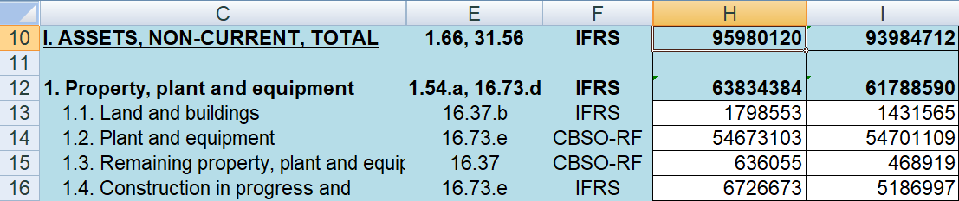
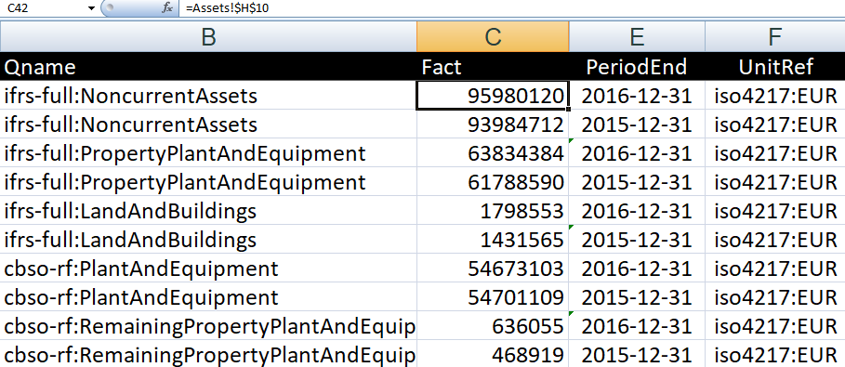
=Assets!H10
Data sheet
Qname, fact and context of each cell.
iXBRL file is a direct syntactical translation.

Slide 5
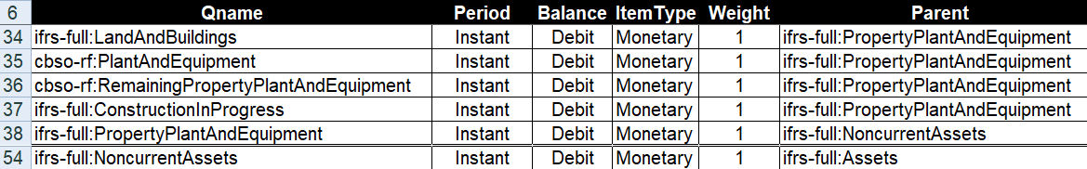
Dictionary sheet
Define the specific accounting plan for this report, aka taxonomy extension
Dictionary and Data sheets are indexed by Qnames
Dictionary generates Calculation, Label (multilingual), Anchoring….

Slide 6


LIVE DEMO/QUESTIONS
Read more at www.openfiling.info/ixbrl
Download RECEiX Open Source program and HANDBOOK

