Slide 1

Arelle® As An XBRL / DPM Open Source Platform
June 22nd 2022
12th OpenFiling General Assembly
Tom Wacha
Director of Product Management
Workiva

Slide 2
Agenda
1
Arelle® overview
4
Working with other products
2
The stewardship of Arelle®
5
Recent and planned improvements
3
The value of open source
6
The Arelle® community

Slide 3



Arelle Overview
Arelle was created in 2010 to improve the accessibility and usability of XBRL in order to increase worldwide adoption of the standard.
Today the Arelle project is used by a global community of over 50 regulators, banks and technology companies that depend on it for data quality and comparison.
Arelle is the world's only open source XBRL platform.

Slide 4

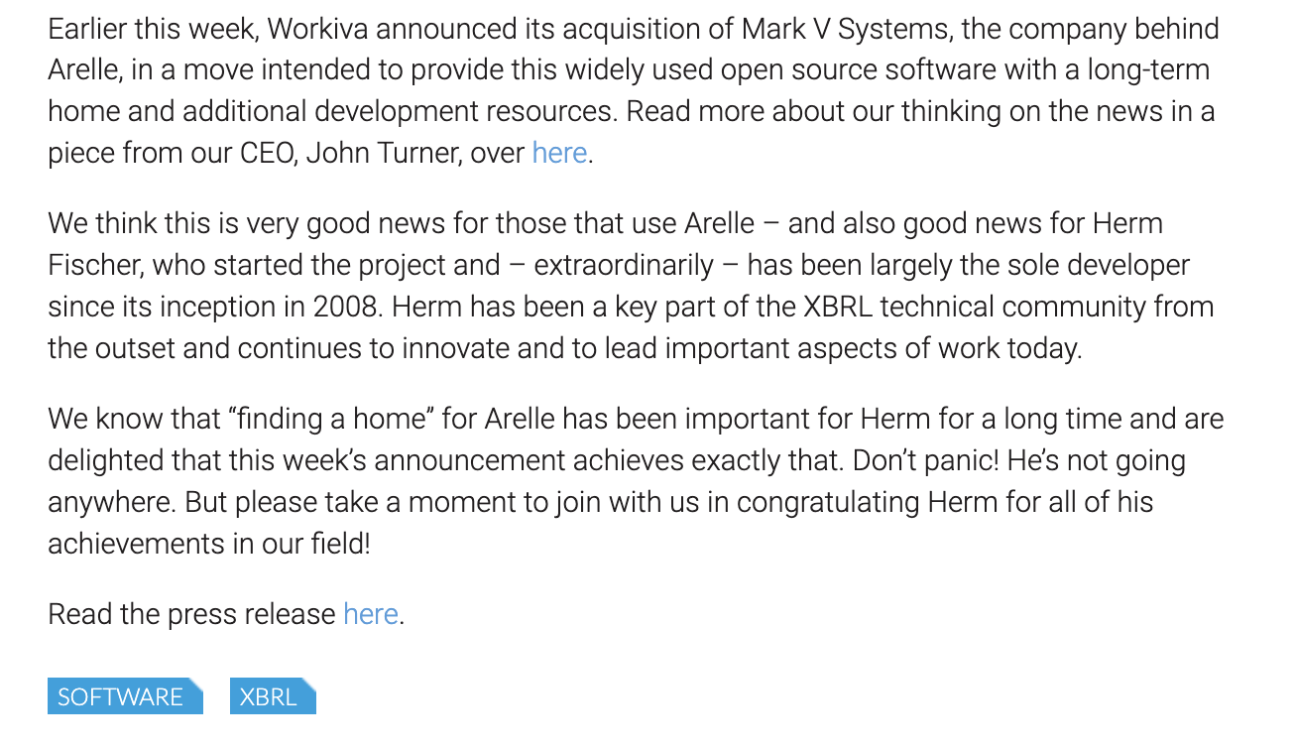
  I know what you're thinking… "What's going to happen now that Workiva acquired Arelle?"
  The answer is: "Business as usual… but better"
  Arelle has been built and grown almost exclusively by longtime XBRL community leader Herm Fischer.
  We needed a plan for continuing Arelle after Herm stops working on it.
  Seeing a need to ensure the continuity of Arelle, Workiva agreed to take over the stewardship of Arelle in December 2021.

Slide 5
Arelle will remain a free, open source resource for the global XBRL community.

Slide 6
Our purpose is to improve the accountability and transparency of business performance globally, by providing the open data exchange standard for business performance.
  XBRL International
  This is the purpose of XBRL International and by extension XBRL Europe
  The problem is… you can't have accountability and transparency without accessibility and usability. That's what open source projects like Arelle offer.

Slide 7
Open Source Software Increases Adoption of XBRL
  When XBRL is more widely adopted, we all benefit

Slide 8




Open Source Software Increases The Adoption of XBRL
It's free, decreasing the overall costs of adoption.
It's readily available, making it easier to access and try out.
The codebase is not owned by anyone, so it can be modified for individual needs.
It's usable, so XBRL becomes more understandable and approachable.

Slide 9
Greater adoption of XBRL means more accountability and transparency.

Slide 10
Arelle Is Complementary, Not Competing
  We firmly believe that open source software and for profit software can co exist and thrive.

Slide 11



Greater Adoption Of XBRL
Increases the need for more robust XBRL software.
Increases the market for complementary and related software products such as XBRL generation and data analysis.
Increases competition by making it easier for proprietary software to fill new markets and solve new problems.

Slide 12


Arelle Objectives
  Easier to use
2. Easier to consume
3. Increase contributions
4. Increase specifications

Slide 13
Recent Improvements
  Easier to use
2. Easier to consume
3. Increase contributions
4. Increase specifications
Documented enterprise grade SDLC for Arelle to include permissions, responsibilities, merging rules and how we will manage contributions of code from the larger Arelle community.
Improved documentation including readme, installation instructions and plugin documentation.
Added additional installation options (pip install).
Improved ESEF Formula speed.
Activated the issues tab in Github for easier feedback and questions.
Certified support for table linkbase.
Initial certification for OIM.

Slide 14
Planned Improvements
  Easier to use
2. Easier to consume
3. Increase contributions
4. Increase specifications
Improving the CI and build process.
Improving testing framework to speed up contribution acceptance time.
Formula performance improvements.
XBRL-CSV performance improvements.
XML parsing performance improvements.
Continued promotion of Arelle via conferences, blog posts and newsletters.
Additional XBRL taxonomy support.
Improved table linkbase processing.
Other opportunities the community deems important.

Slide 15
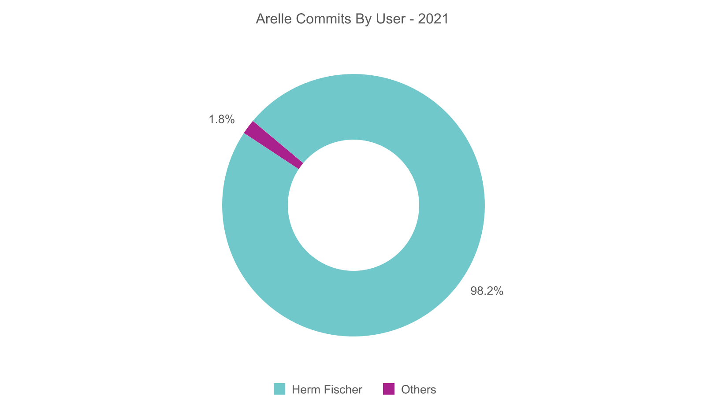
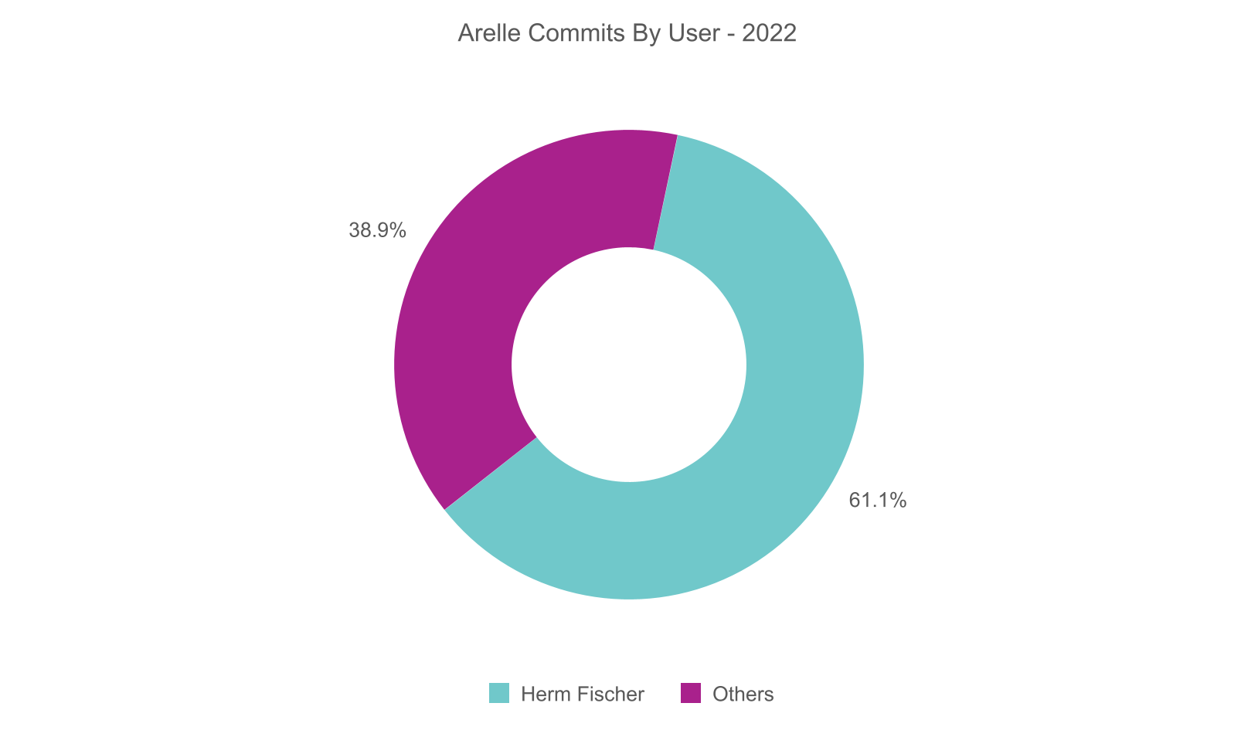
The Arelle Community
3 total contributors
11 total contributors

Slide 16
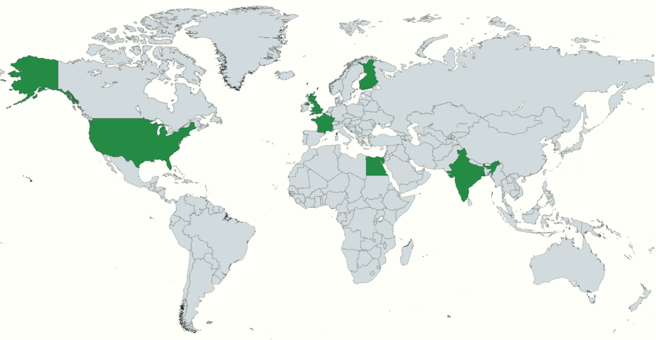
The Arelle Community
Contributors from 7 countries

Slide 17

The Arelle Community
We want you!
  We are actively looking for contributors to Arelle.
  The future of Arelle will be what we make of it.
  Visit arelle.org to learn more and contribute.

Slide 18
Thank You
arelle.org

